Slide 1
Introduction to Data Science Week # 1

Slide 2
Lecture Outline
Why data science? What is data science?
What is this class and what it is not?
The data science process
Example

Slide 3
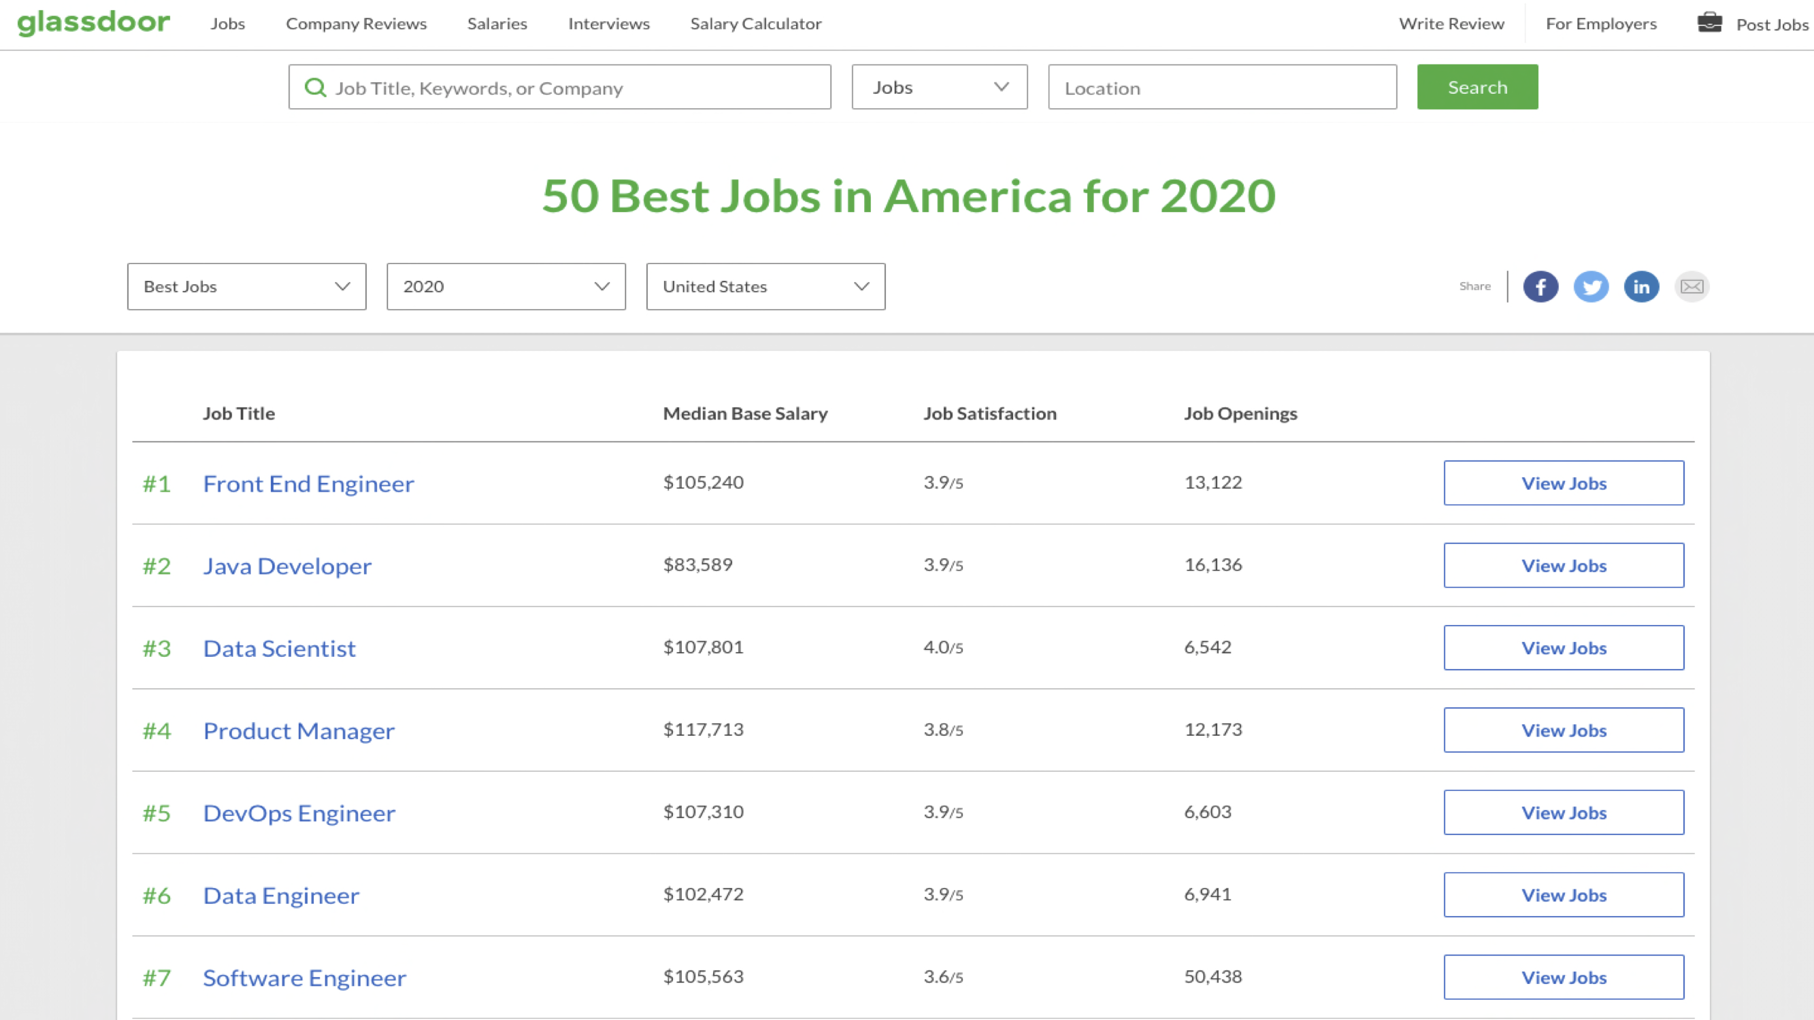
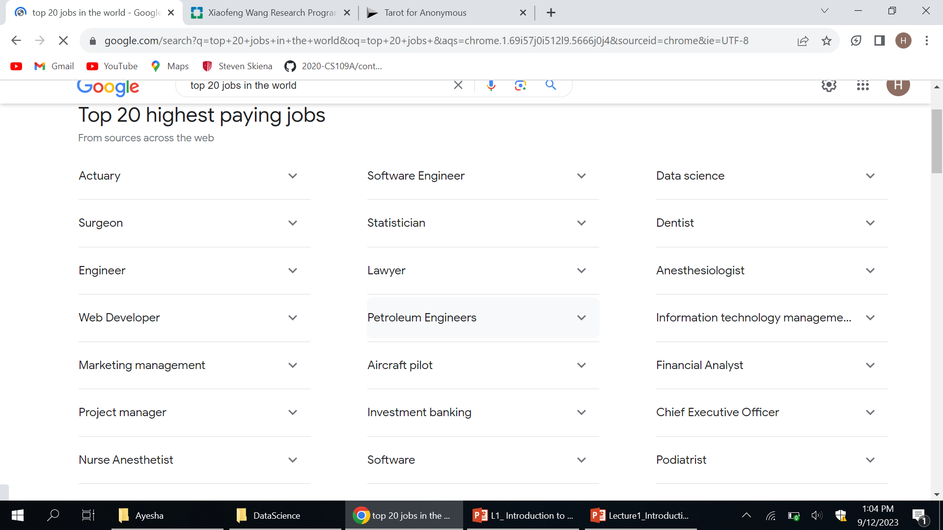
Why?
Jobs!

Slide 4
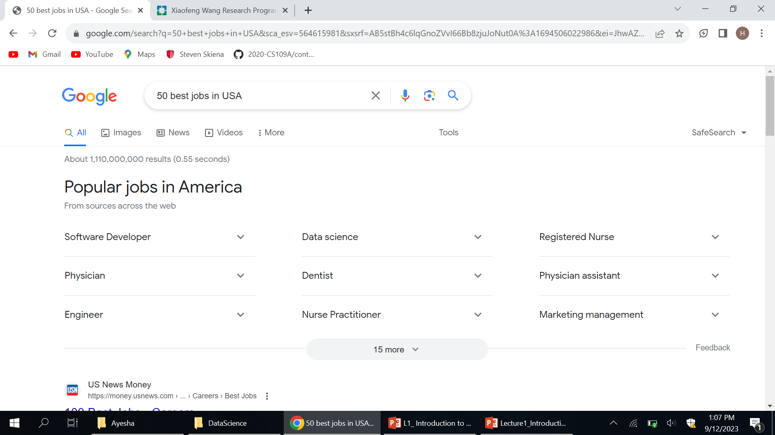
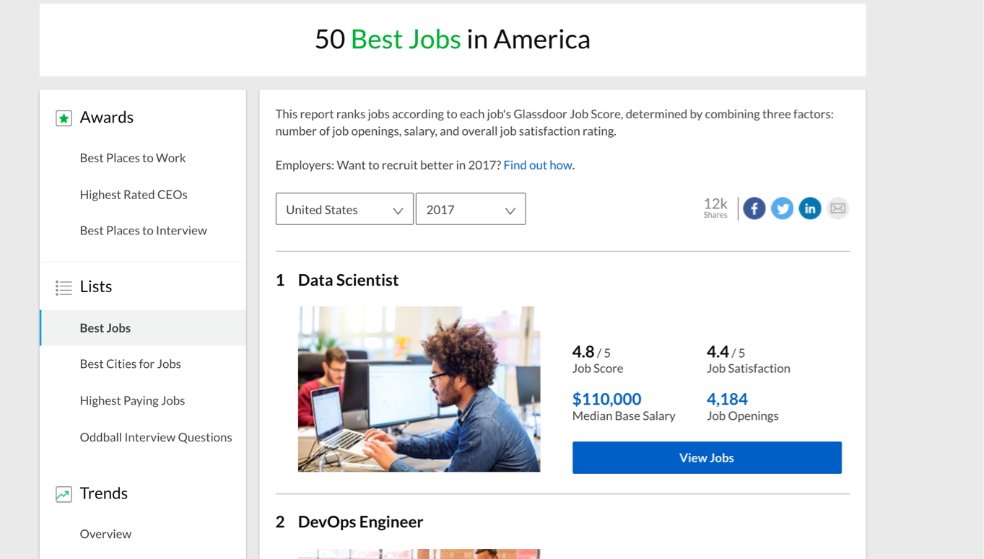
Why?
Jobs!

Slide 5
History
Long time ago (thousands of years) science was only
empirical and people counted stars

Slide 6
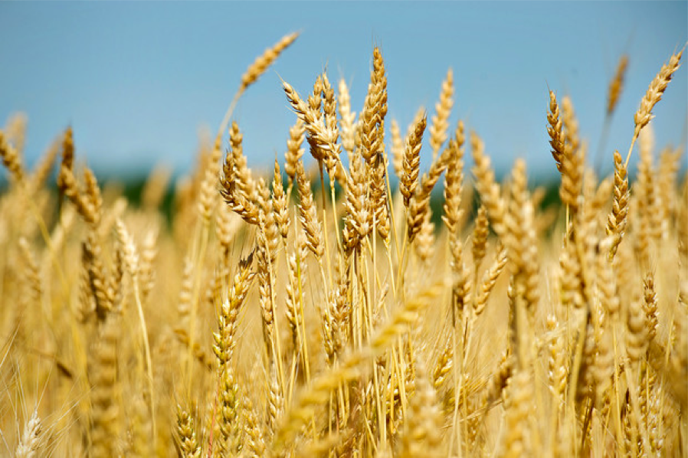
History (cont)
Long time ago (thousands of years) science was only
empirical and people counted stars or crops

Slide 7
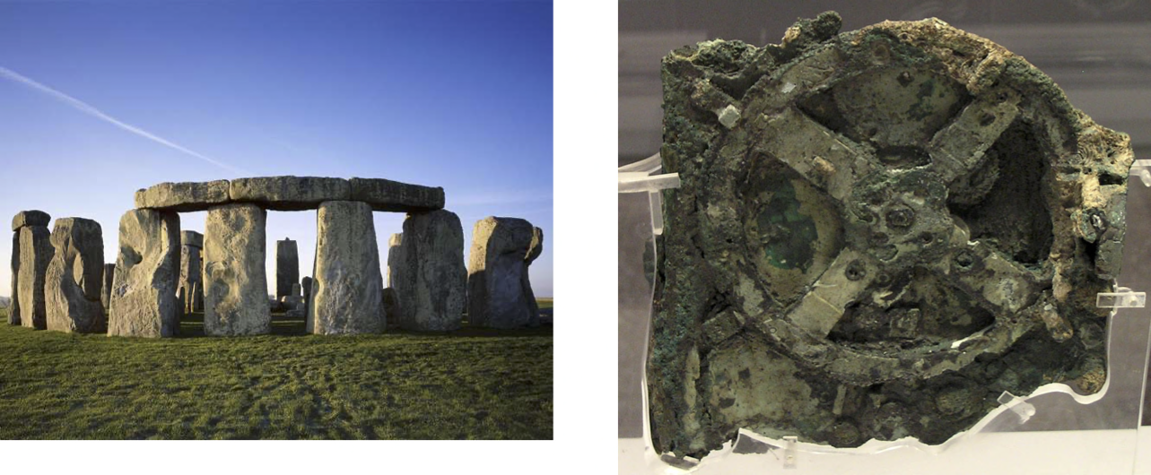
History (cont)
Long time ago (thousands of years) science was only
empirical and people counted stars or crops and used the data to create machines to describe the phenomena
Notes:
Stonehedge: 3000 BC to 2000 BC. astronomical significance of the site for its people, are a matter of speculation and debate.
Antikithira mechanism 150 and 100 BC It is a complex clockwork mechanism composed of at least 30 meshing bronze gears.

Slide 8
History (cont)
Few hundred years: theoretical approaches, try to derive
equations to describe general phenomena.

Slide 9


History (cont)
About a hundred years ago: computational approaches
Notes:
Eniac

Slide 10
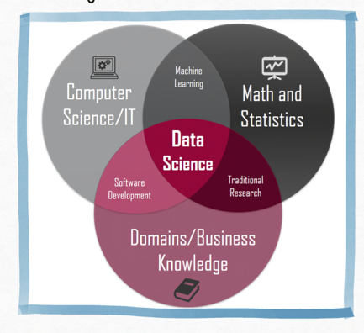
History (cont)
And then …. data science
In both data science and machine learning we extract pattern and insights from data.
Inter-disciplinary
Data and task focused
Resource aware
Adaptable to changes in the environment and needs
Notes:
Eniac

Slide 11
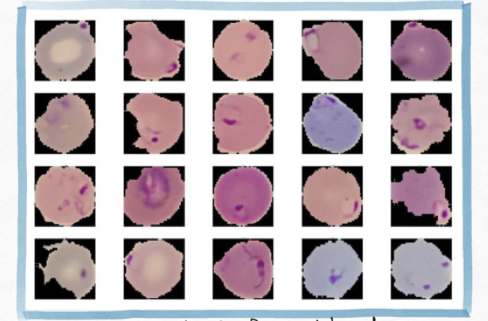
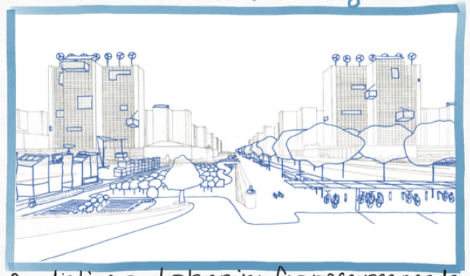

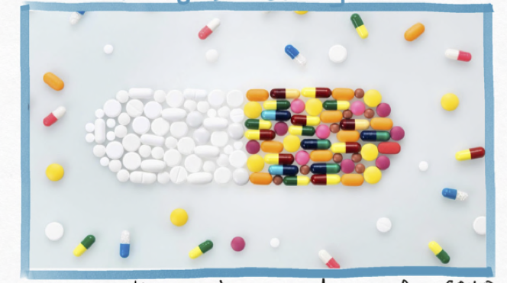
The Potential of Data Science
Disease Diagnosis
Urban Planning
Detecting malaria from blood smears
Predicting and planning for resource needs
Agriculture
Drug Discovery
Quickly discovering new drugs for COVID
Precision agriculture

Slide 12



The Potential of Data Science
Gender Bias
Racial Bias
Some DS models for evaluate job applications show bias in favor of male candidate
Risk models used in US courts have shown to be biased against non-white defendants

Slide 13
Genius vs. Wisdom
Software developers are hired to produce code.
Data Scientists are hired to produce insights.
Genius shows in finding the right answer!!!
Wisdom shows in avoiding the wrong answers.
Data science (like most things) benefits more from wisdom than from genius.

Slide 14
Developing Wisdom
Wisdom comes from experience.
Wisdom comes from general knowledge.
Wisdom comes from listening to others.
Wisdom comes from humility, observing how often you have been wrong and why/how.
I seek pass on wisdom, through my experience on the difficulty of making good predictions.

Slide 15
Developing Curiosity
The good data scientist develops a curiosity about the domain/application they are working in.
They talk shop with the people whose data they are working on.
They read the newspaper every day, to get a broader perspective on the world.

Slide 16
Asking Good Questions
Software developers are not encouraged to ask questions, but data scientists are:
What exciting things might you be able to learn from a given data set?
What things do you/your people really want to know?
What data sets might get you there?

Slide 17
Let’s Practice Asking Questions!
Who, What, Where, When, and Why on the following datasets:
Baseball-reference.com
International Movie Database (IMBb)
Google ngrams
NYC taxi cab records

Slide 18
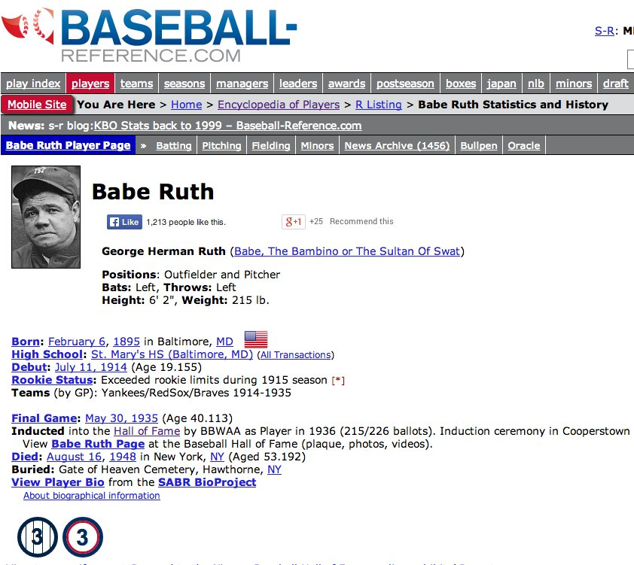
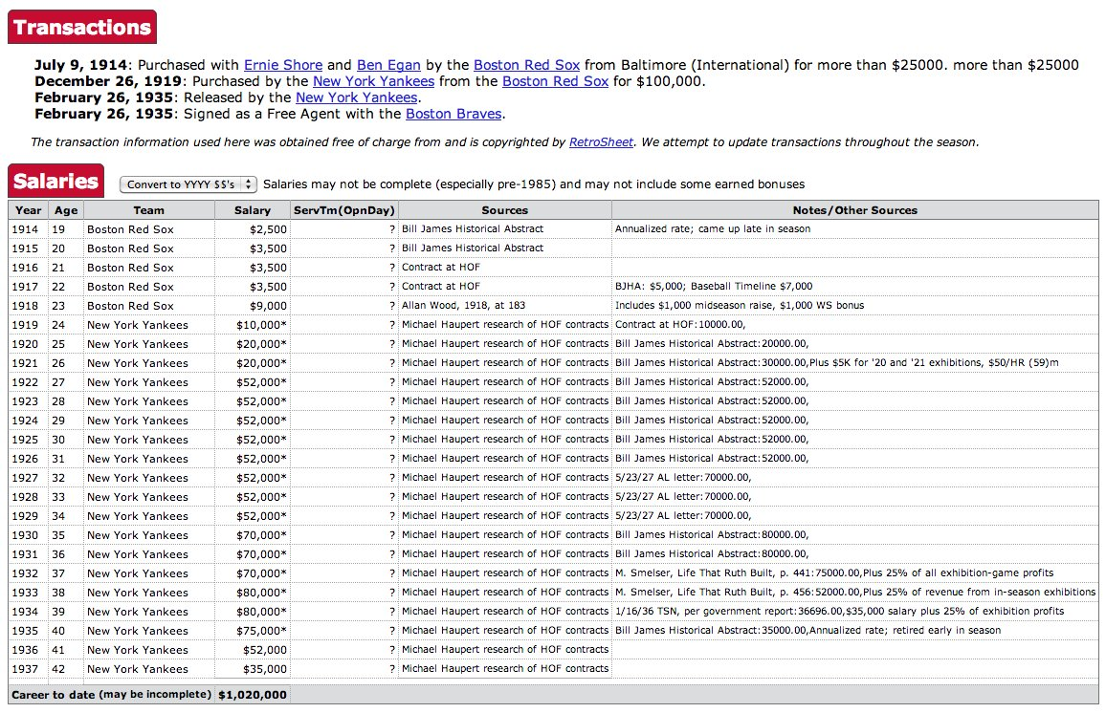
Baseball-Reference.com: biosketch

Slide 19
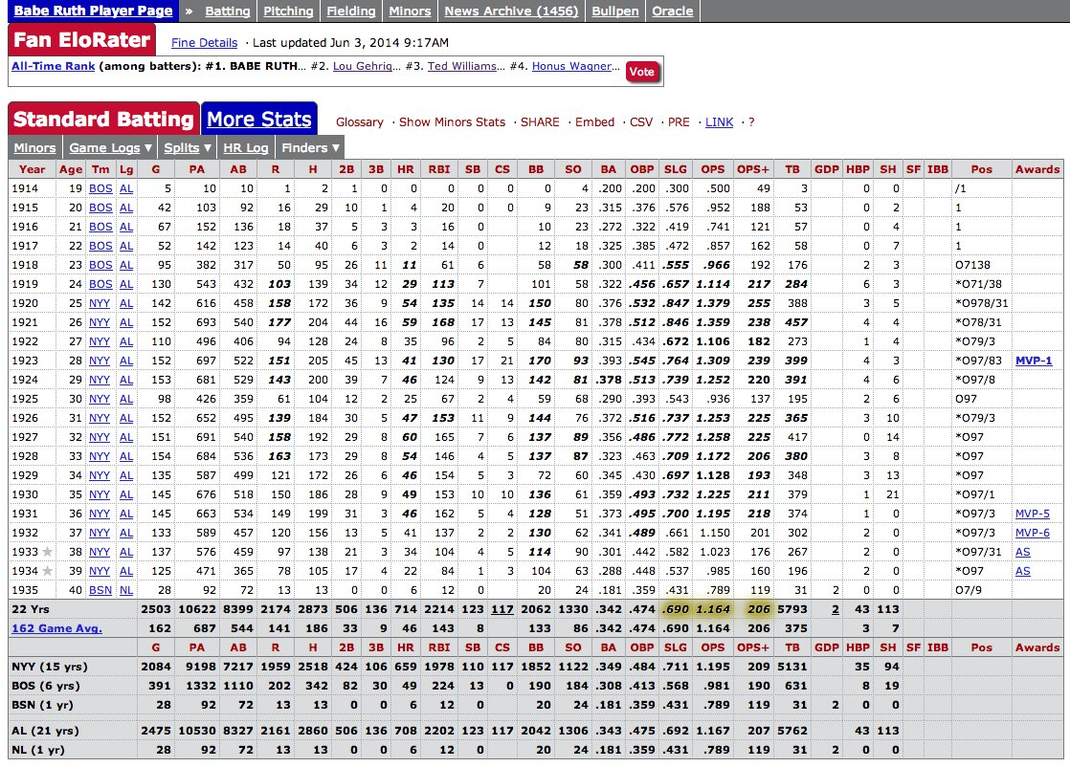
Statistical Record of Play
Summary statistics of each years batting, pitching, and fielding record, with teams and awards.

Slide 20
Baseball Questions
How to best measure individual player’s skill, value or performance?
How fair do trades between teams work out?
What is the trajectory of player’s performances as they mature and age?
To what extent does batting performance correlate with the position played?

Slide 21
Demographic Questions
Do left-handed people have shorter lifespans than right-handers?
How often do people return to where they were born?
Do player salaries reflect past, present, or future performance?
Are heights and weights increasing in the population?

Slide 22
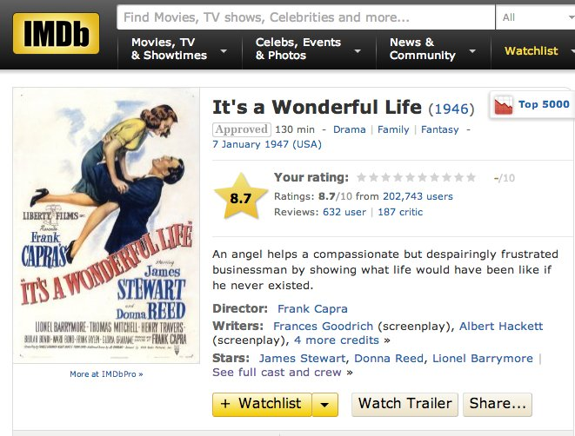
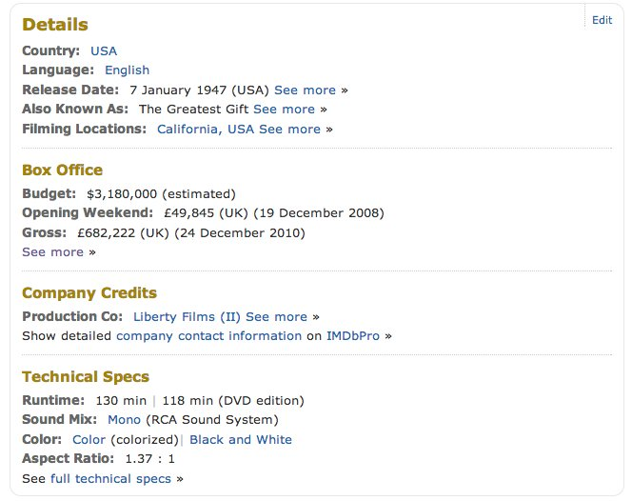
IMDb: Movie Data

Slide 23
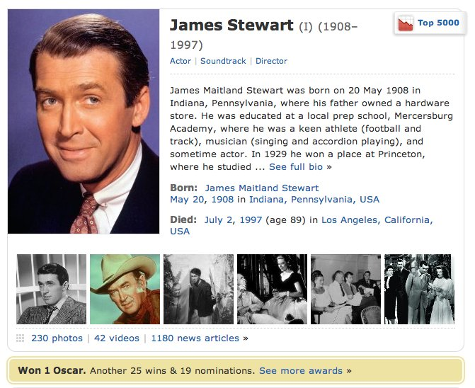
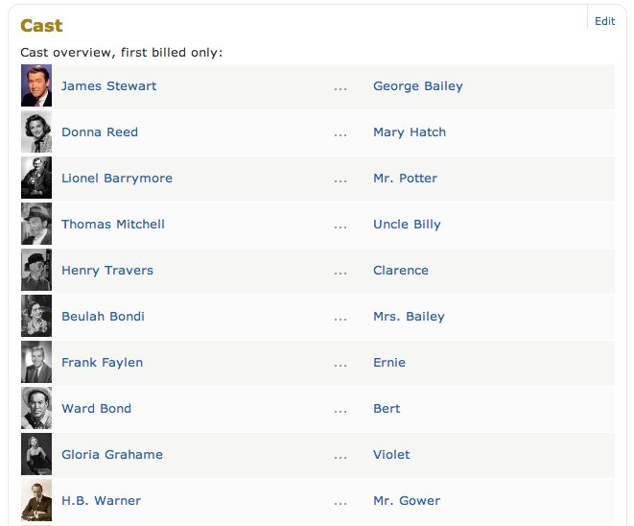
IMDb: Actor Data

Slide 24
Movie Questions
Can we predict how well people will like a movie? What about its gross?
What does the social network of actors look like? (Six degrees of Kevin Bacon)
What is the age distribution of actors and actresses in film?
Do stars live longer or shorter lives than the bit players or public?

Slide 25
Google Ngrams
Presents an annual time series of the frequency of every “popular” word/phrase with 1 to 5 words occurs in scanned books.
`Popular’ means appears >40 times in total.
Google has scanned about 15% of all books ever published, making this resource quite comprehensive.

Slide 26
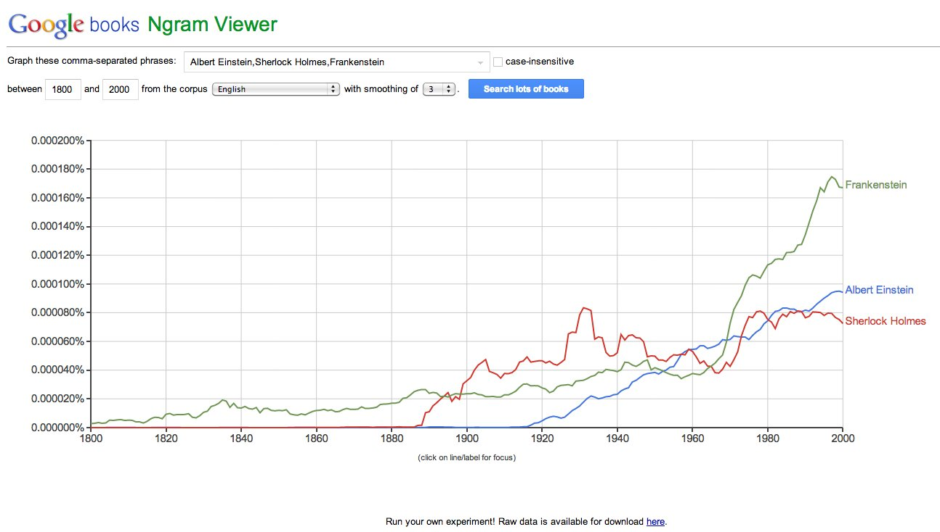
Google Ngram Viewer

Slide 27
Ngram Questions
How has the amount of cursing changed over time?
What is the lifespan of fame and technologies? Is it increasing/decreasing?
How often do new words emerge? Do they stay in common usage?
What words are associated with other words, i.e. can you build a language model?

Slide 28
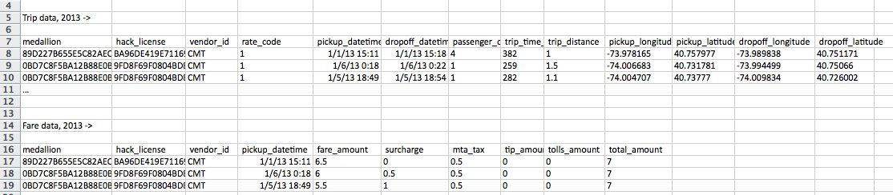
NYC Taxi Cab Data
Gives driver/owner, pickup/dropoff location, and fare data for every taxi trip taken.
Data obtained from NYC via Freedom of Information Act Request (FOA)

Slide 29
Taxicab Questions
How much do drivers make each night?
How far do they travel?
How much slower is traffic during rush hour?
Where are people traveling to/from at different times of the day?
Do faster drivers get tipped better?
Where should drivers go to pick up their next fare?

Slide 30
What?
The Data Science Process
Ask an interesting question
Get the Data
Explore the Data
Model the Data
Communicate/Visualize the Results

Slide 31
What?
The Data Science Process
Ask an interesting question
What is the scientific goal?
What would you do if you had all of the data?
What do you want to predict or estimate?
Get the Data
Explore the Data
Model the Data
Communicate/Visualize the Results

Slide 32
What?
The Data Science Process
Ask an interesting question
How were the data sampled?
Which data are relevant?
Are there privacy issues?
Get the Data
Explore the Data
Model the Data
Communicate/Visualize the Results

Slide 33
What?
The Data Science Process
Ask an interesting question
Plot the data.
Are there anomalies or egregious issues?
Are there patterns?
Get the Data
Explore the Data
Model the Data
Communicate/Visualize the Results

Slide 34
What?
The Data Science Process
Ask an interesting question
Build a model.
Fit the model.
Validate the model.
Get the Data
Explore the Data
Model the Data
Communicate/Visualize the Results

Slide 35
What?
The Data Science Process
Ask an interesting question
What did we learn?
Do the results make sense?
Can we effectively tell a story?
Get the Data
Explore the Data
Model the Data
Communicate/Visualize the Results

Slide 36
What?
The material of the course will integrate the five key facets of an investigation using data:
data collection; data wrangling, cleaning, and sampling to get a suitable data set.
data management; accessing data quickly and reliably.
exploratory data analysis; generating hypotheses and building intuition.
prediction or statistical learning.
communication; summarizing results through visualization, stories, and interpretable summaries.

Slide 37
Goal of the course
Theory
Practice
Impact
Key Machine Learning concept
Important metrics for evaluation
Handling different kinds of data
Extracting insights from analysis of the models
Implement ML and deep learning models using python libraries
Using free online tools and resources for data science
Solving real-life problems using DS
Evaluating the social impact of DS

Slide 38

Statistics. Math. Computer Science. Physics. Long ago, the four disciplines lived together in harmony. Then, everything changed when the Computer Science attacked. Only a master of all four elements, could stop them, but when the world needed it most, it was not invented. A few years ago the world discovered the new master, a scientist called data scientist, a master of all four elements

